Slide 1

Reinforcement Learning

Slide 2

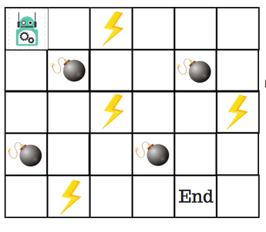
Q-learning

Slide 3
The Game Rule
If the robot steps on a mine, the point loss is 100 and the game ends.
If the robot gets power ⚡️, it gains 1 point.
If the robot reaches the end goal, the robot gets 100 points.

Slide 4
How do we train a robot to reach the end goal with the shortest path without stepping on a mine?

Slide 5
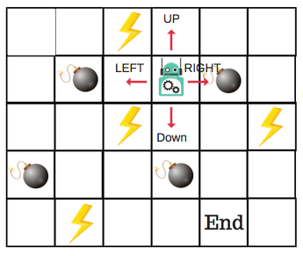
Q-Table

Slide 6
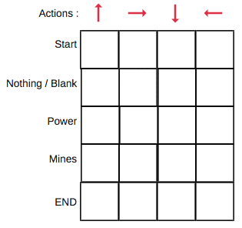
Q-Table

Slide 7
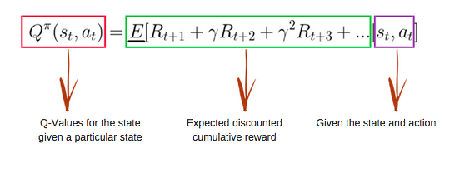
Q-Function
Notes:
上面那个式子是conditional expectation

Slide 8
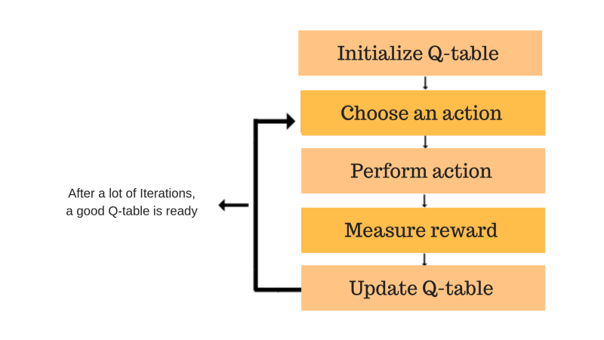
The Algorithm

Slide 9
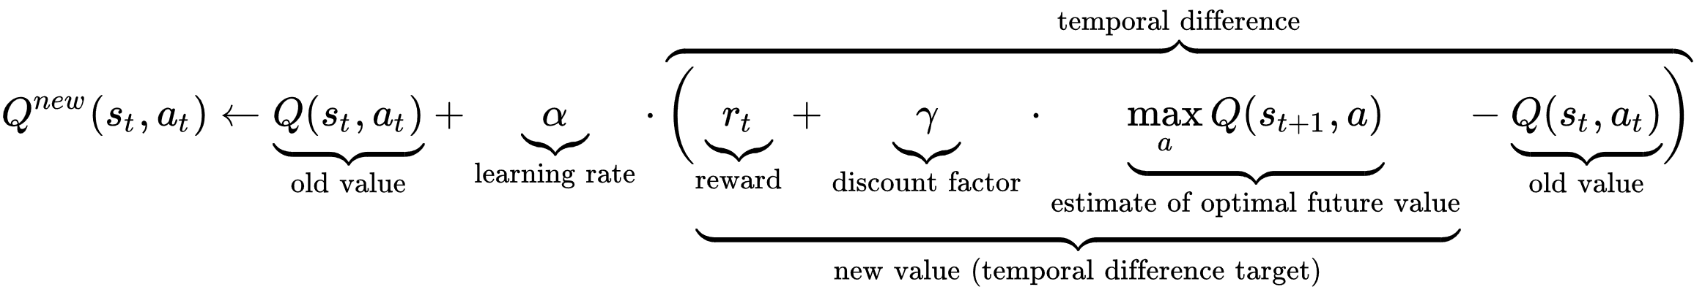
Updating Equation

Slide 10
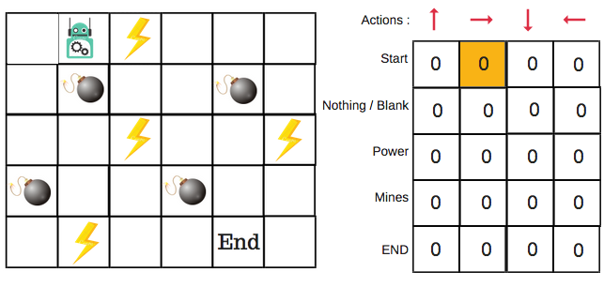
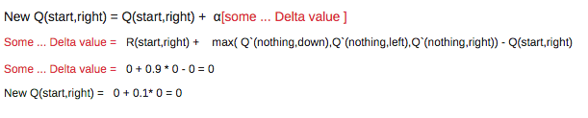
Updating Q-Table

